Slide 1


Stocks with the highest Gain: 1996 to 2020
Project By:
Mason Barrios
Joaquin Flores
Jasmine Gomez
Dylan Mora

Slide 2

Introduction
Stock Data from 1996 to 2020
Dataset (12GB) from Kaggle.com provided by Dip Modi
104,123 individual stock tickers
Pig utilized to analyze data
HDFS used for storage
Link to Dataset (2GB Compressed, 12GB Unzipped): https://www.kaggle.com/aceofit/stockmarketdatafrom1996to2020

Slide 3
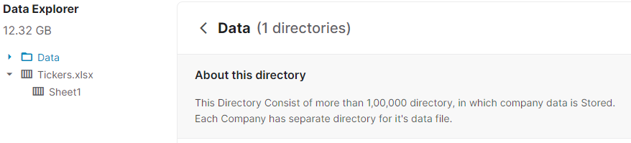
Introduction
Dataset (12GB) from Kaggle.com provided by Dip Modi
104,123 individual stock tickers

Slide 4
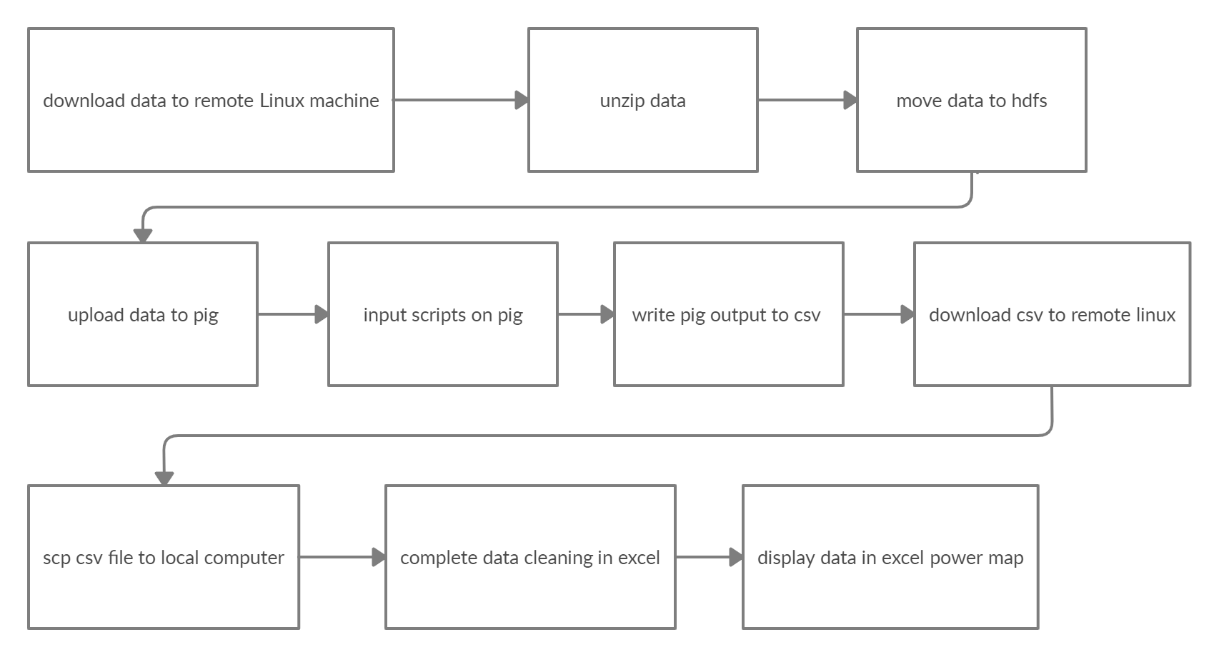
Workflow chart

Slide 5
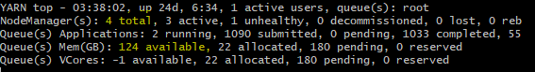
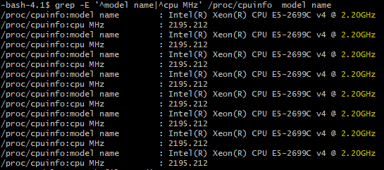
specifications
Cluster Version: Hadoop 2.7.1.2.4.2.0-258
Number of Nodes: 4
Memory: 180GB
CPU: Intel(R) Xeon(R) E5-2699C v4
CPU Speed: 2.20GHz

Slide 6
retrieving the data
WGET is used to download the data locally.
Due to insufficient space, dataset is downloaded to temporary file systems (tmpfs /dev/shm).

Slide 7
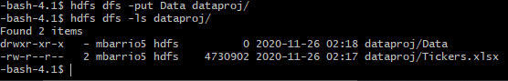
Moving the data
From the Linux machine, we move the data to HDFS via the –put command
This function takes 1 hour and 10 minutes to complete

Slide 8
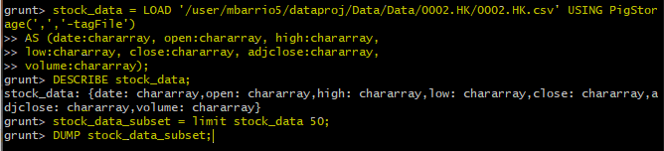
Using apache Pig
In pig we create a sample script and test it against one stock ticker
After we determine the schema, we modify the script to include all 104,123 stock tickers

Slide 9
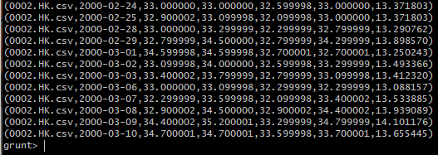
Example of test output

Slide 10
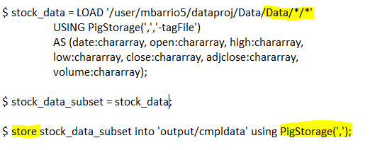
Finalizing pig script
Script is revised after testing and all 104,123 tickers are stored into a single file (~13GB, process takes ~15 minutes)

Slide 11
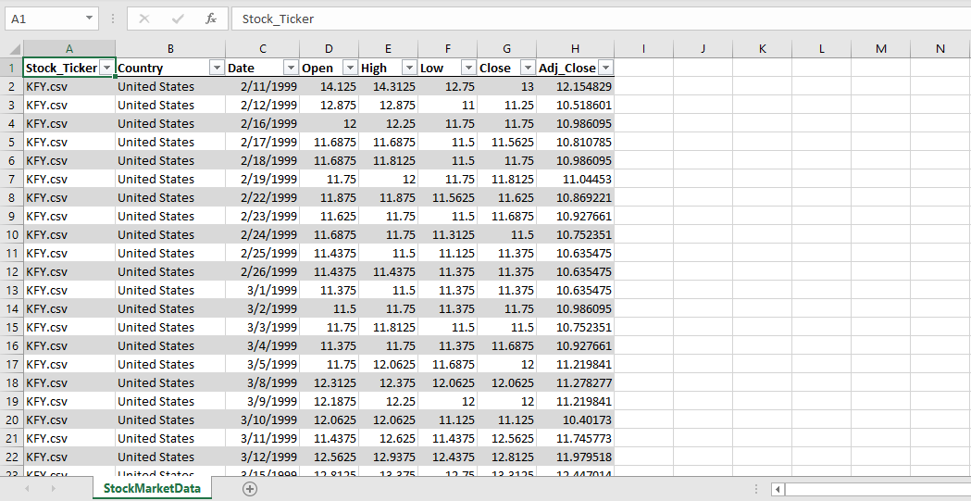
Data in excel

Slide 12
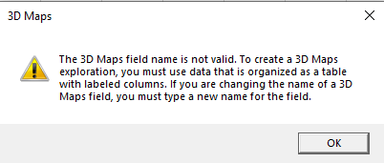
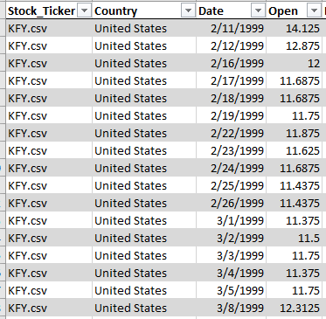
Issues with the project
Time Series (Excel Error)
Excel did not accept "DATE" column
We were unable to include a TIME dimension to the data visualization
Some countries insufficient data, ex: Brazil

Slide 13
findings: Greatest gains by country
Stock Name | Country | Increase | Industry
GPTX (Global Payments Technologies) | United States | Δ 6,194 | Banking
LTA.PA (Altamir SCA) | France | Δ 6,080 | Finance
GOW.AX (Gowing Asset Management) | Australia | Δ 6,273 | Finance
JAM/L (JP Morgan) | United Kingdom | Δ 6,278 | Banking
PSH.V (Petrolshale Inc.) | Canada | Δ 6,113 | Energy
007370.KQ (Jin Yang Pharmaceutical Co.) | Korea | Δ 5,035 | Pharmaceutical

Slide 14
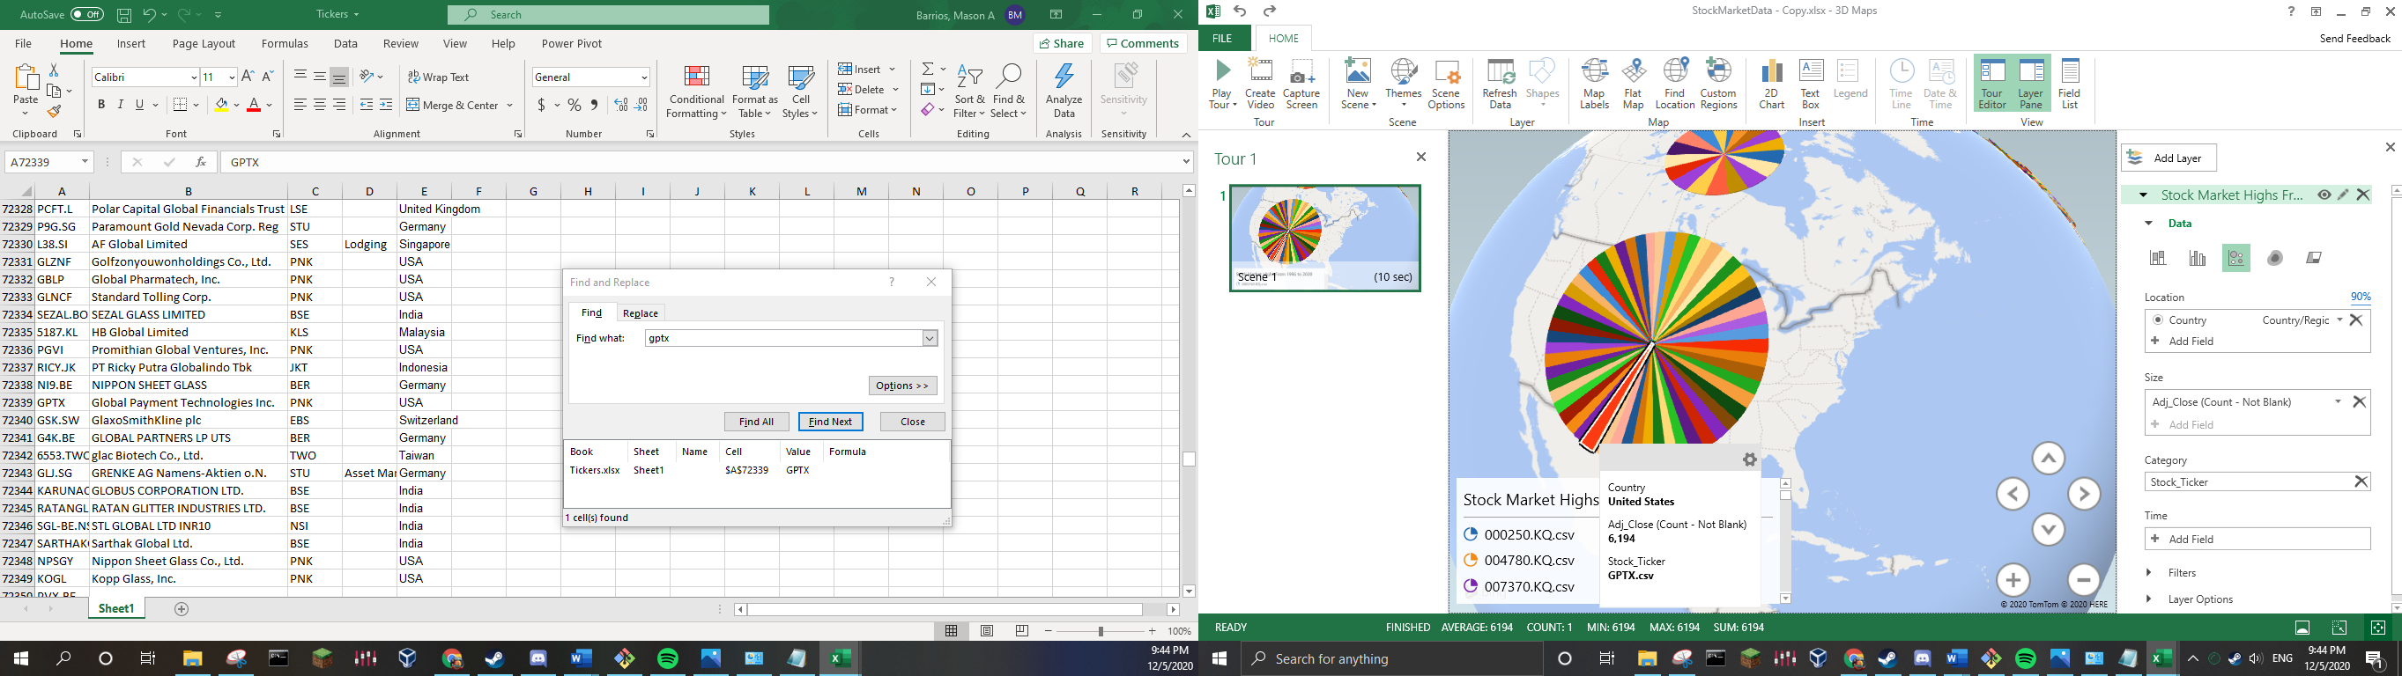
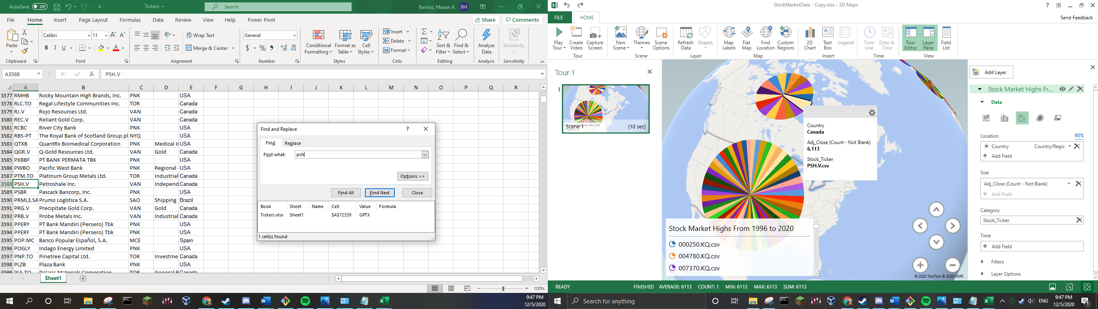
GPTX (US) and PSH (Can)

Slide 15
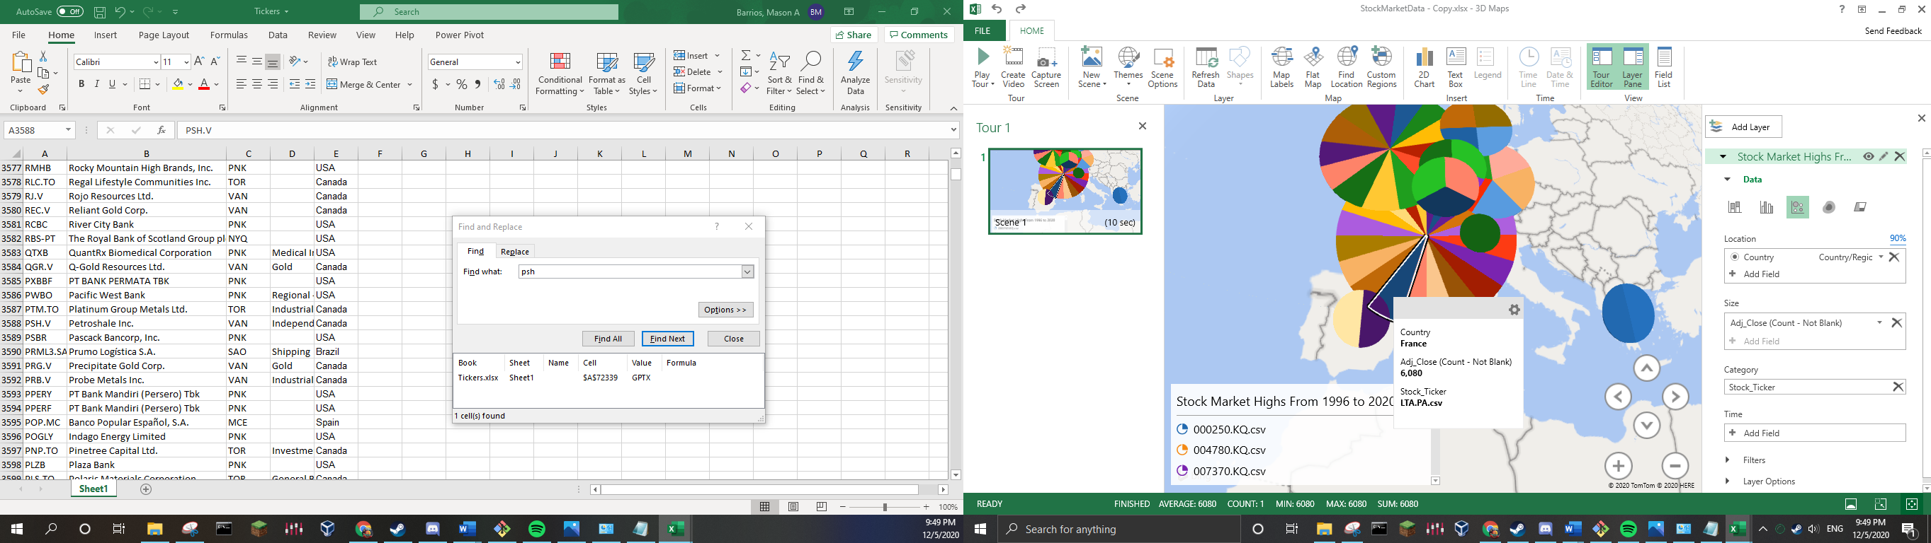

Lta.pa (fra) and jam.l (UK)

Slide 16

GOW.AX (AUS)

Slide 17
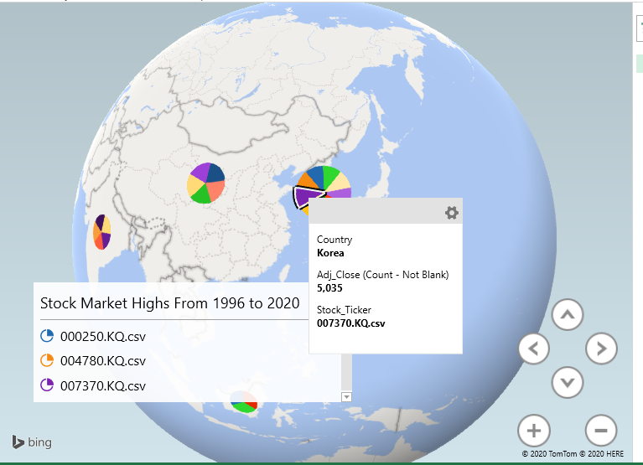
007370.KQ (Korea)

Slide 18
Related works
Long short-term memory model (LSTM) : LSTM is a technique subtle for processing and predicting important events. LSTM is an extended variant of RNN, a deep learning model that is good at processing time-series data.
Empirical Mode Decomposition (EMD) : EMD is a signal analysis method; it can decompose a complex signal into a finite intrinsic mode function (IMF)

Slide 19

Conclusion
Out of the countries sampled, financial institutions (or finance related) stock tickers saw the highest gains over the course of 24 years. For the US, France, UK, and Australia this was the case. For Korea it was a pharmaceutical company, and for Canada, an energy company.

